Slide 1
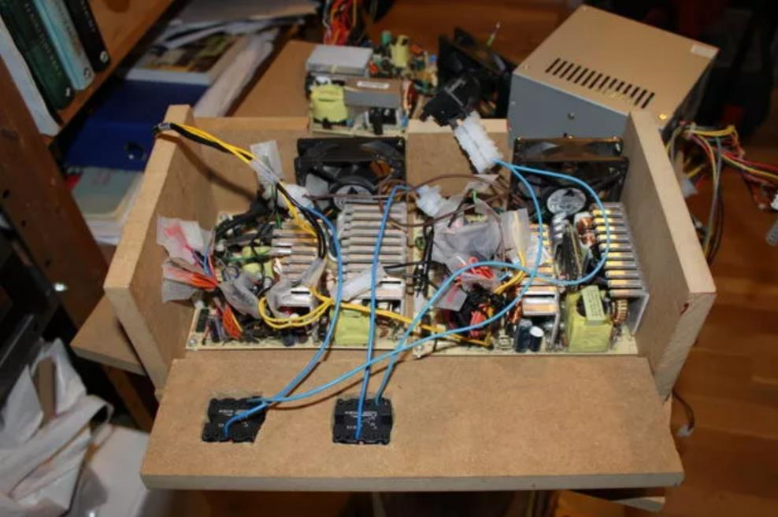
Intro to Electronics
Dec-2023

Slide 2


Rules of thumb, assumptions and mixed-quality analogies to come!

Slide 3
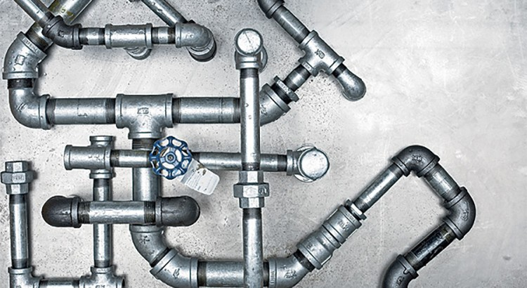
Plumbing Analogy

Slide 4
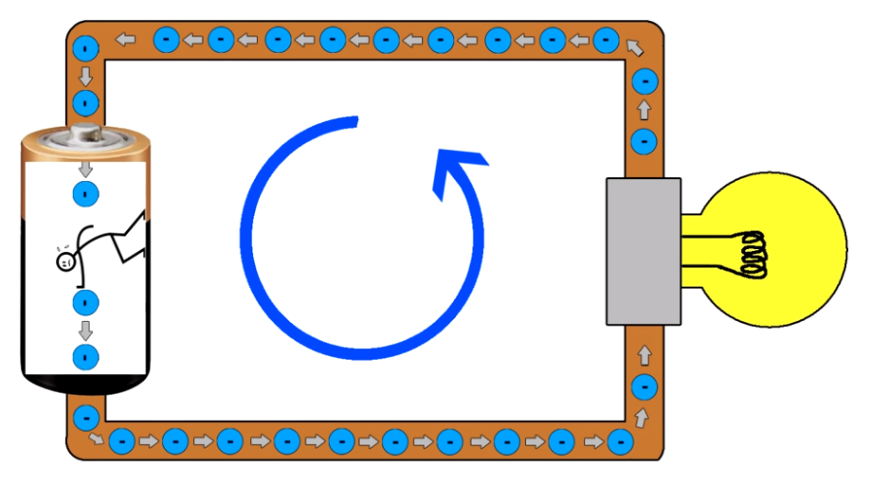
Powering a Light Bulb
Voltage is the pressure (pushing force)
Pushes electrons through a circuit

Slide 5
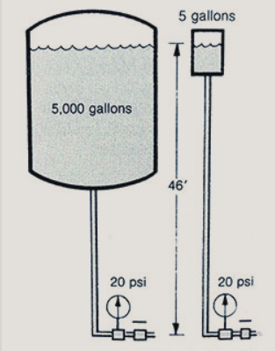
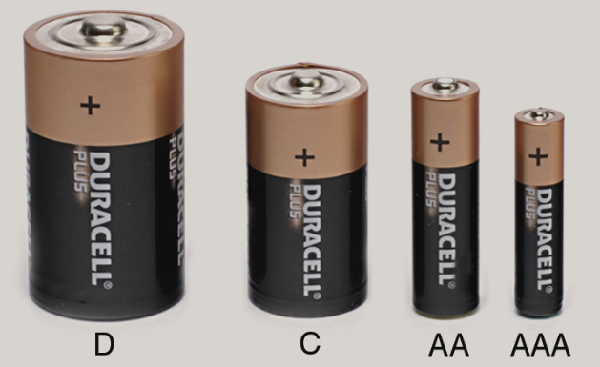
Voltage
+
+
+
+
1.5V
1.5V
1.5V
1.5V
-
-
-
-

Slide 6
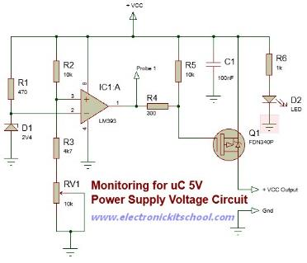
Powering a Complex Circuit
12V
Voltage is applied across any circuit to power it

Slide 7
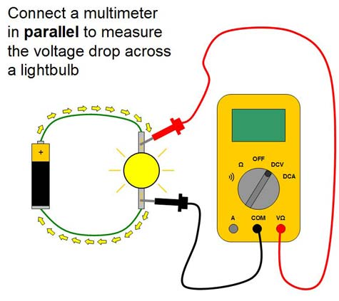
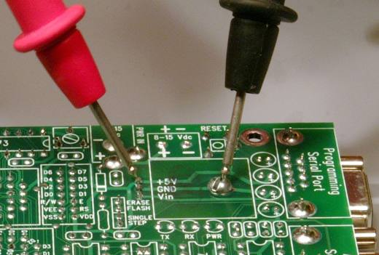
Measuring Voltage
Voltage is measured between/across two points:
Positive minus negative
Convention - red minus black

Slide 8
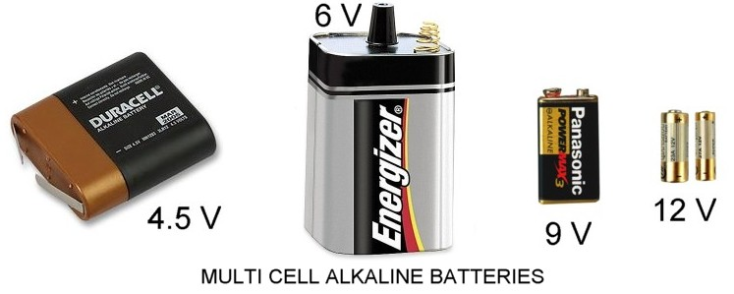

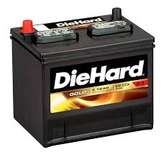
Common Voltages
Volts DC:
9V or 9VDC or 9V DC
110 volts AC
110V or 110V AC or
110VAC
12V DC or
12V

Slide 9
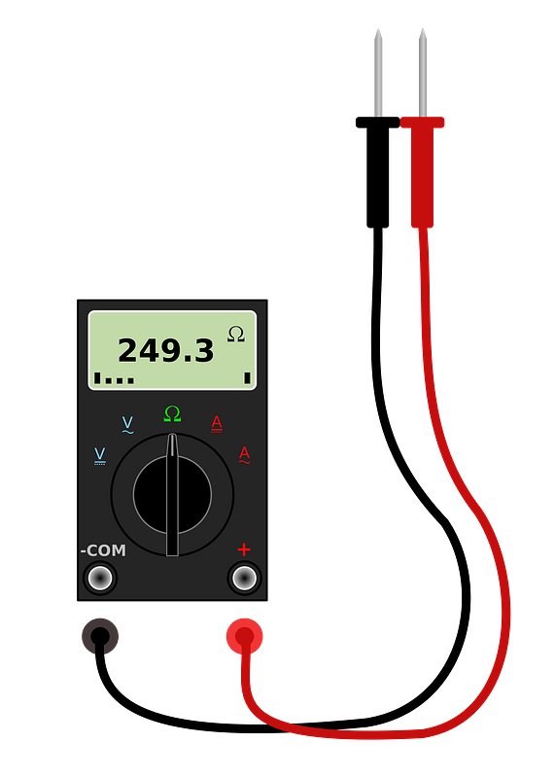
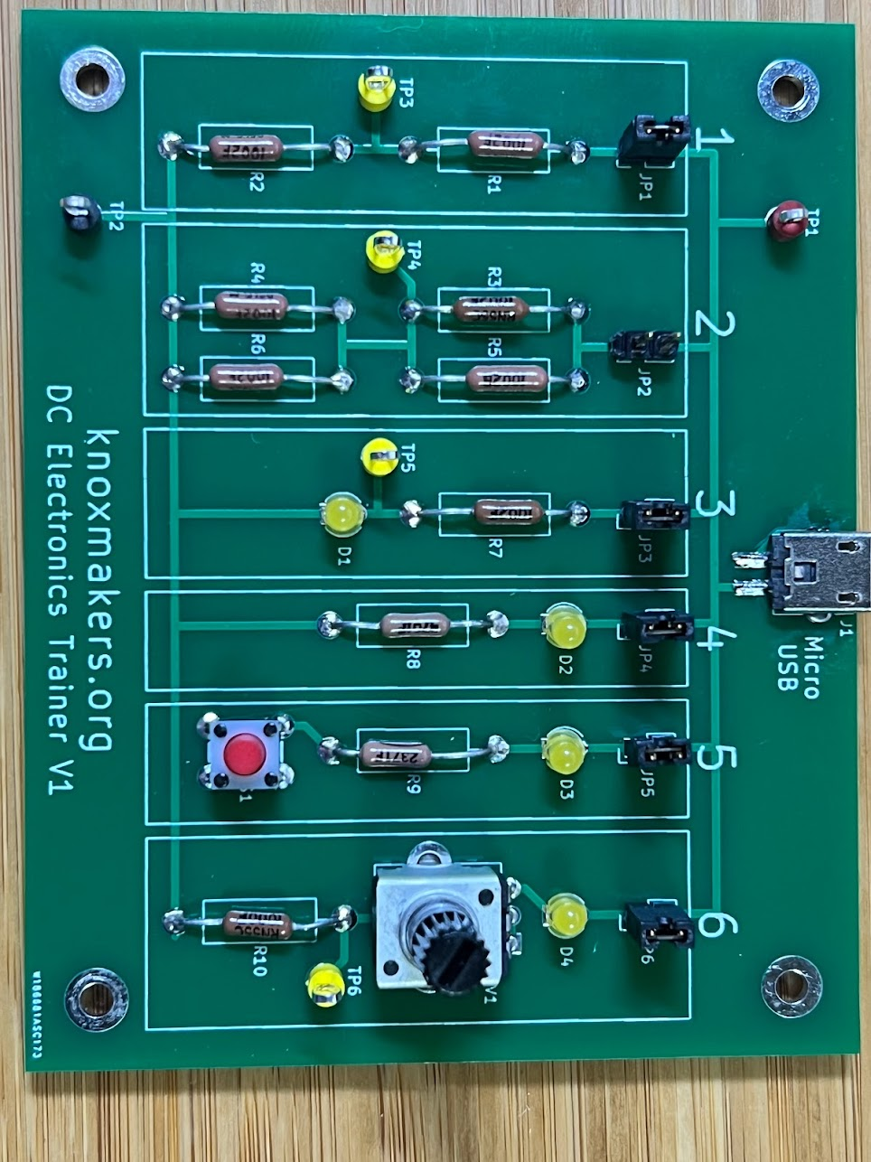
Let’s Try It!
5V DC
Jumper
2.5V DC
Ground

Slide 10
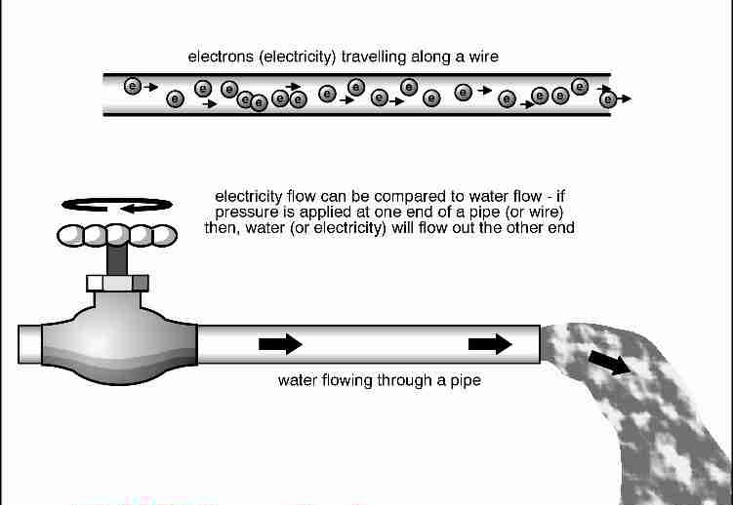
Current
Current is the flow of electrons
Similar to the flow of water

Slide 11
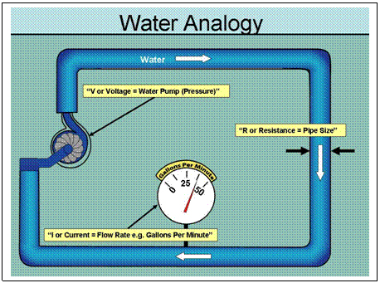
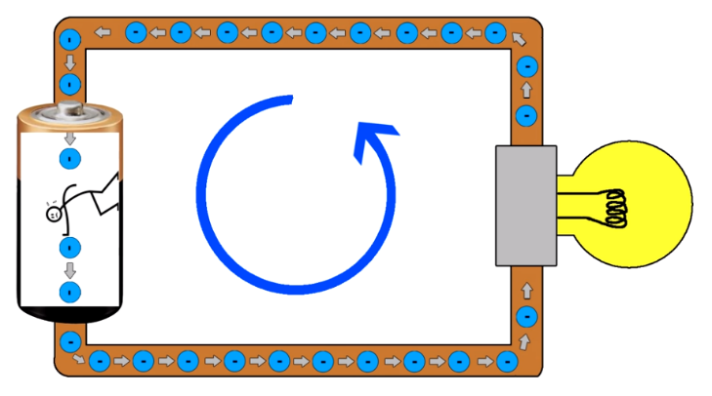
Current
Measured in amps
1A (1 amp) = 6.25 x 10¹⁸ electrons per second

Slide 12
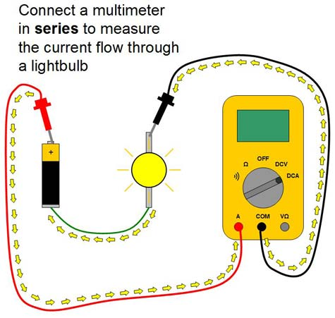
Measuring Current
Current can be measured by passing it through a multimeter

Slide 13
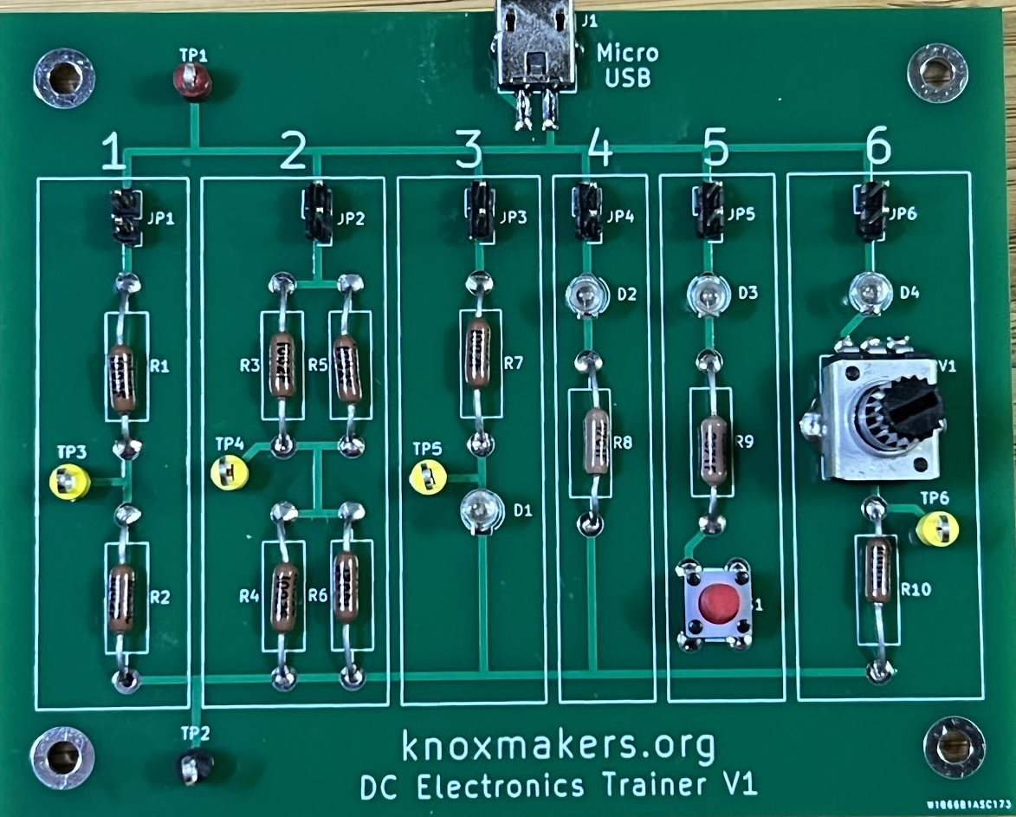
Let’s Try It!
~0.5mA DC
Remove Jumper

Slide 14
“Voltage Across” – “Current Through”
Voltage
Current

Slide 15
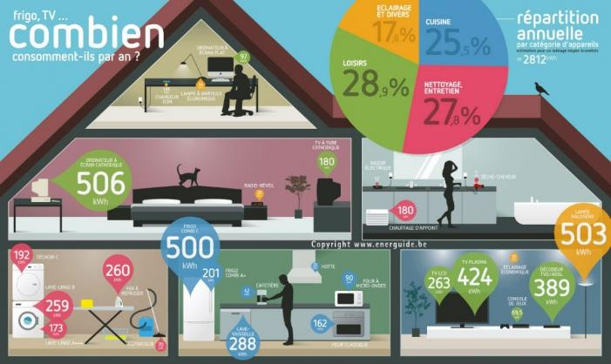
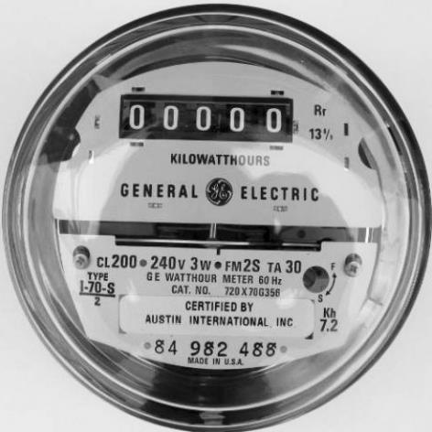
Power
Power = Watts = Amount of energy used at a particular point in time
Energy =
Power x Time = W x hr
Total energy used over a period of time

Slide 16
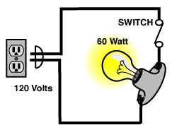
Calculating Power
Power = Voltage x Current
120V x 0.5A = 60W

Slide 17
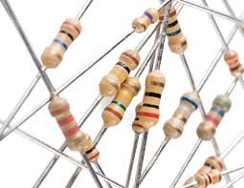
Resistors – A minute to learn, a lifetime to master

Slide 18

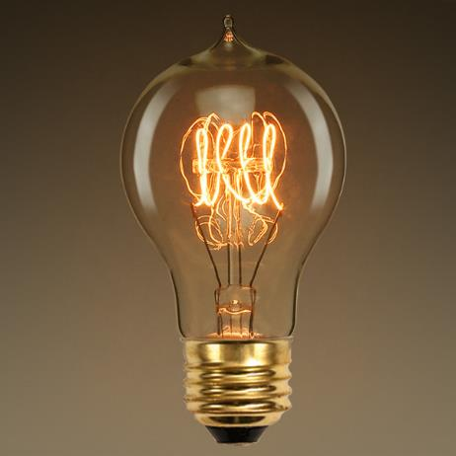
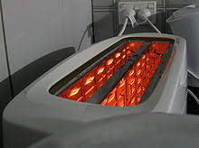
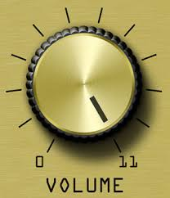
We use them every day

Slide 19
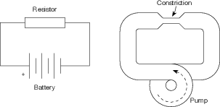
Resistors – Resist the flow of current
Resistance – measured in Ohms (Ω)

Slide 20
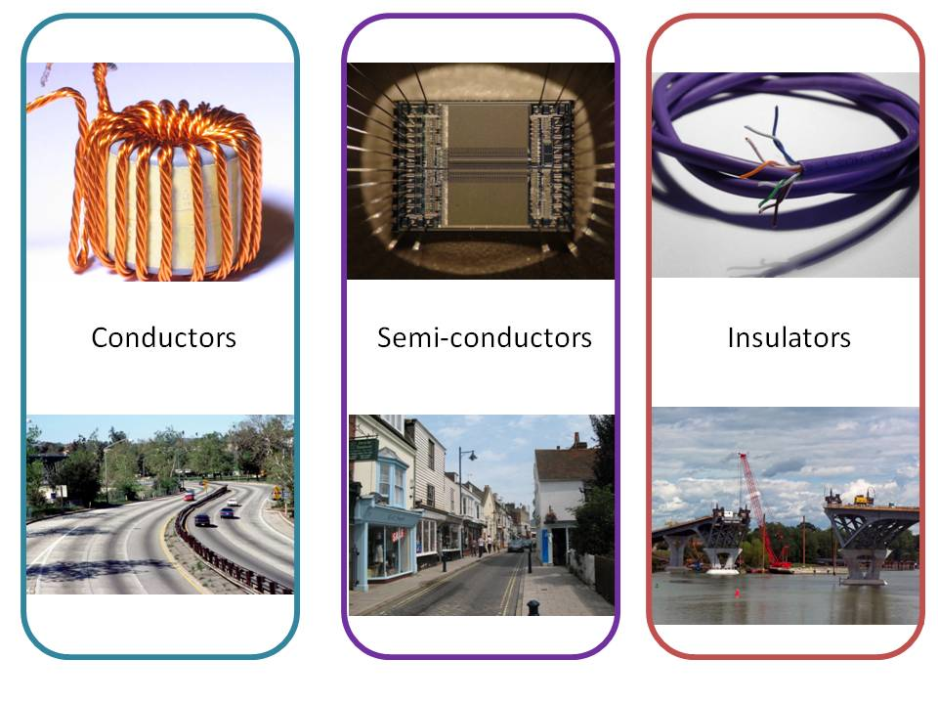
Conductors vs Insulators

Slide 21
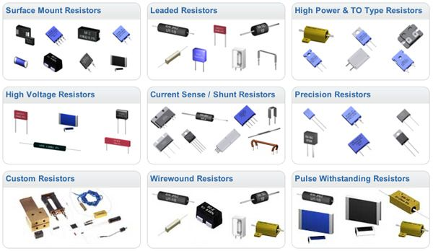
All Shapes and Sizes

Slide 22
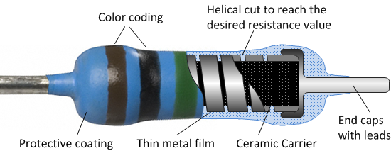
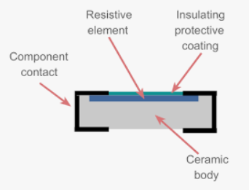
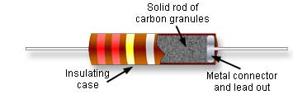
Fixed Resistors – Construction

Slide 23
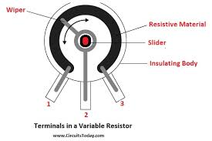
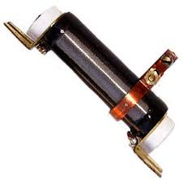
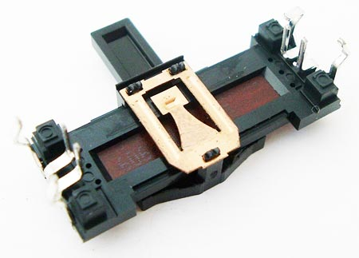
Variable Resistors – Construction

Slide 24
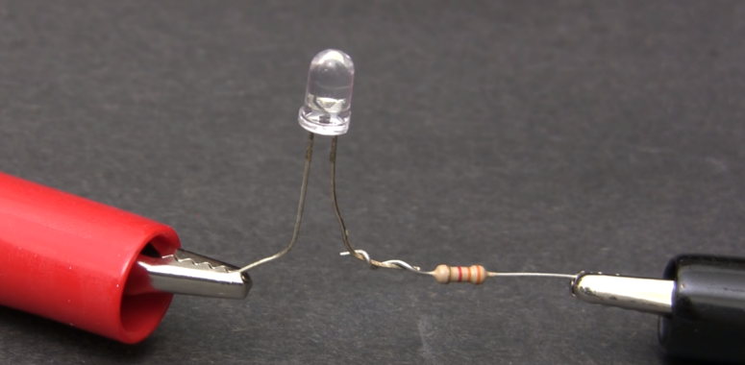
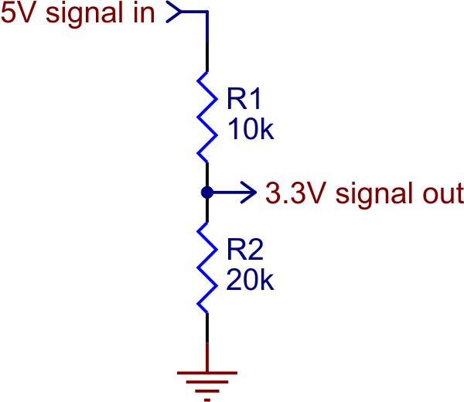
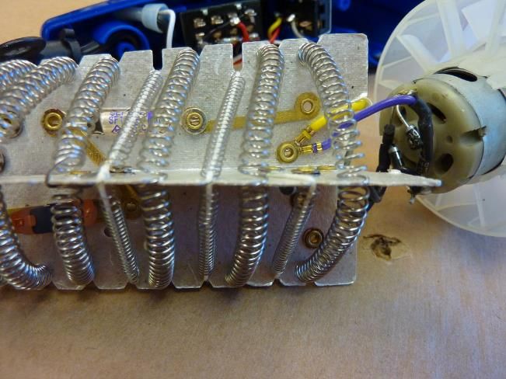
Resistors – Simple but useful!

Slide 25
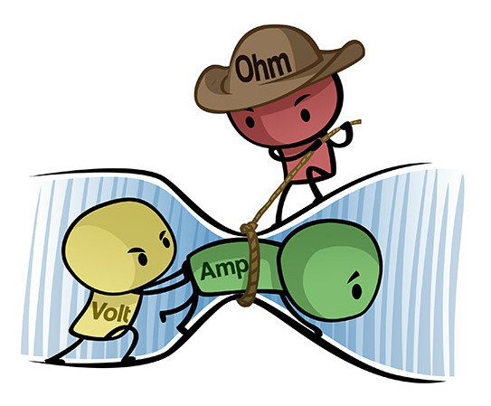
Ohm’s Law
V = I * R
Special Relationship between voltage, current, resistance

Slide 26
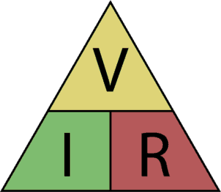
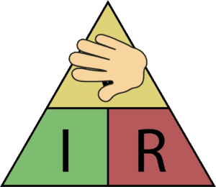
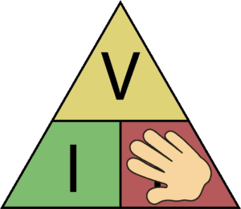
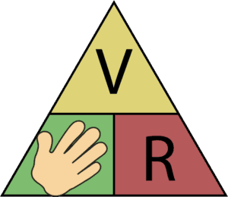
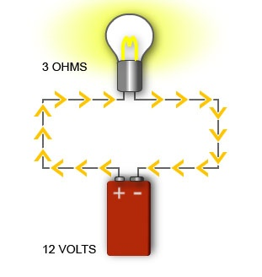
Ohm’s Law
V = I * R
R = V / I
I = V / R
R=?
I=0.5A
I=?
120V

Slide 27
Let’s Try It!
Remove jumper, measure R
R = 4.7kΩ
Place jumper, measure V
V = I * R
R = V / I
V = 2.5V
I = V / R
Remove jumper, measure I
V = 0.53mA

Slide 28
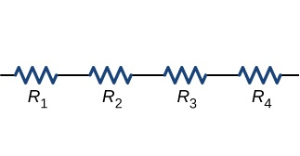

Resistors in Series
=
10Ω
10Ω
10Ω
10Ω
40Ω
R₁ + R₂ + R₃ + R₄

Slide 29
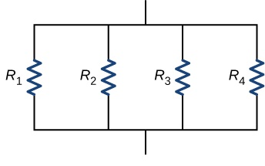

Resistors in Parallel
=
40Ω
40Ω
40Ω
40Ω
R_{T}
10Ω
1
R_{T} =
1
R₁
+
1
R₂
+
1
R₃
+
1
R₄

Slide 30
Let’s Try It!
Remove jumpers, measure each R
10kΩ
5kΩ
R₁ = R₂ = 10kΩ
R₃//R₅ = 5kΩ
R₃ = R₅ = 10kΩ
10kΩ

Slide 31
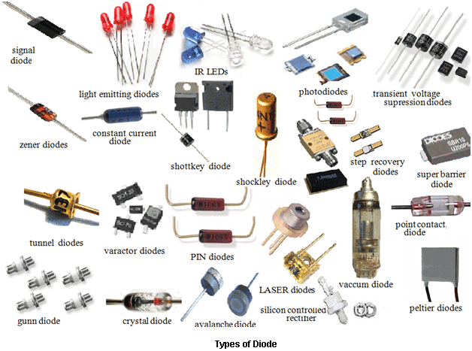
Diodes/LEDs

Slide 32
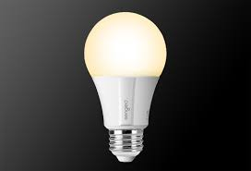

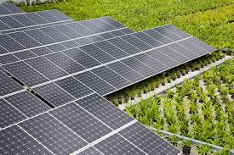
Diodes – Everyday Uses

Slide 33
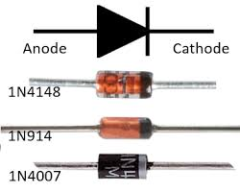
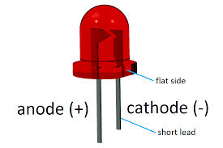
Diodes – One-Way Gate
Current Flow
LED

Slide 34
How to use a diode
I_{LED}
R
V_{S} > V_{LED} + 1V
I_{LED} ~ 10-20mA
V_{LED} ~ 1.8-3.3V
V_{S}
+
-
+
V_{LED}
-

Slide 35
Practical Circuit
I = 10mA
V_{S} = 5V
R = ?
+
-
+
V_{LED} = 2V
R = V / I
-
R = (5V – 2V) / 0.01A
= 3V / 0.01A
= 300Ω

Slide 36
Let’s Try It!
Turn knob to set brightness
Remove jumper, measure R
R = 100Ω
Place jumper, measure V
V = I * R
R = V / I
V = 2.5V
I = V / R
Remove jumper, measure I
V = 0.53mA

Slide 37
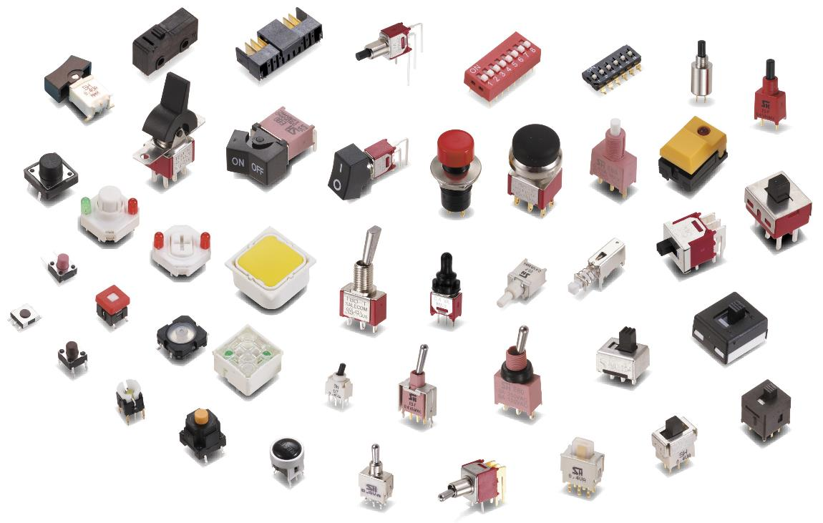
Switches

Slide 38

Capacitors

Slide 39


Similar to Batteries

Slide 40


“Supply Bypass” Capacitors

Slide 41
Further Reading
Falstad Circuit Simulator – Runs in Browser
Kahn Academy – Introduction to EE
Mattermost Channel
YouTube Videos
All About Circuits
https://www.allaboutcircuits.com/education/
Sparkfun – learn.sparkfun.com
Adafruit - learn.adafruit.com/

